Slide 1





Emotion Recognition
The process of a computer reading your pretty face
Rec. Img
Identify Face
Process Input
Img Shape
Analysis
Open CV
Normalize
Numpy

Slide 2
Cascade Model

Slide 3
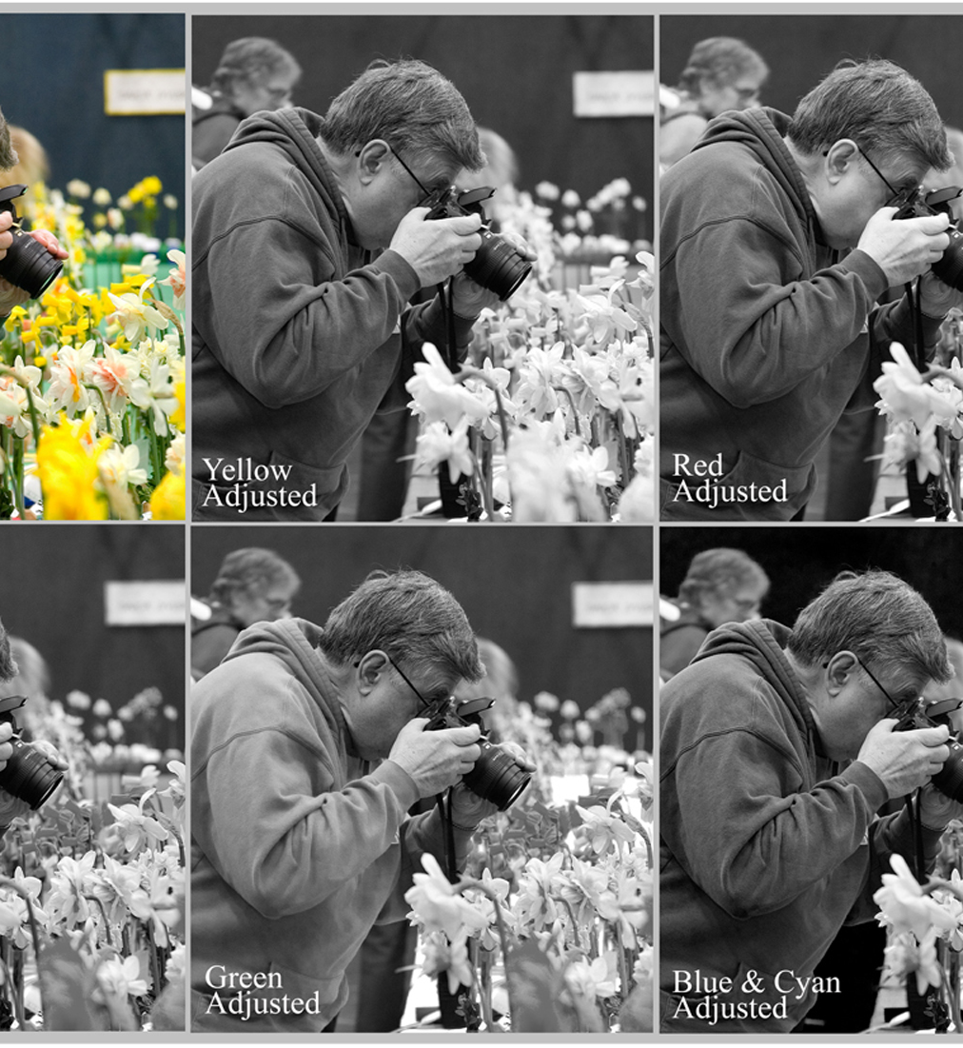
Preprocess_input()
Normalize all the pixels
Reason: That’s how the model was trained…?
It helps clearing the noise from different light setting
Imagine a very dark setting image vs a very light setting image

Slide 4
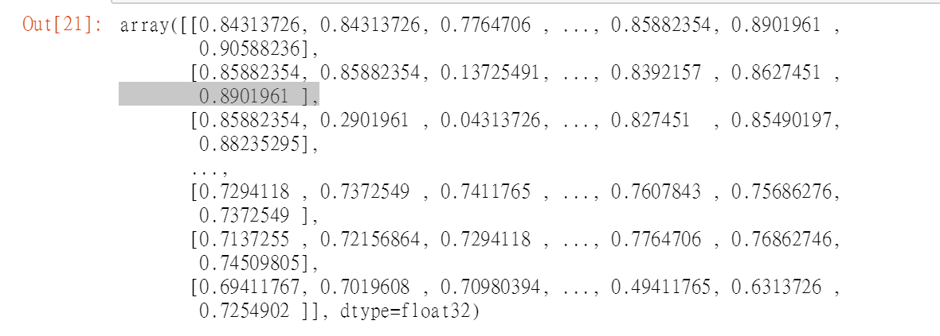
Image Shape
The image is an 48 by 48 array of pixels
Computer doesn’t understand it.
Np.expand_dims(processed, 0) add one bracket to the array, or adding one dimension to it.
Np.expand_dims(processed, -1) add one bracket to each pixel

Slide 5
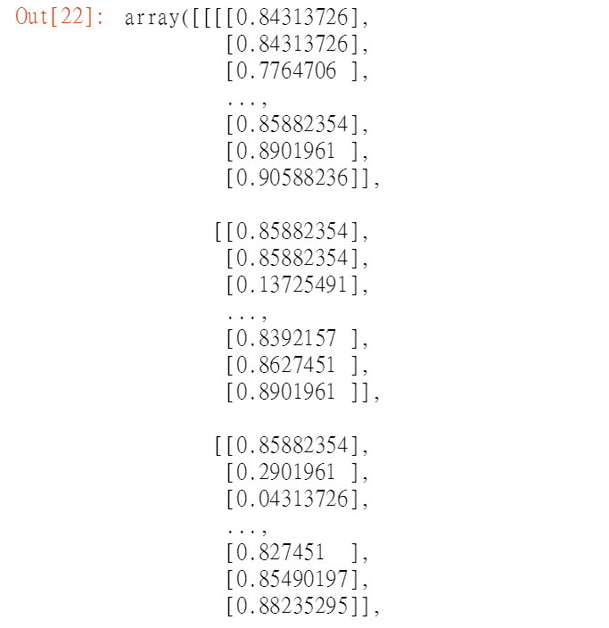
Image shape cont.
What does that all mean?????
By changing it to a (1,48,48,1) array from (48,48) you are telling the machine, there is one picture of 48 by 48 pixel with one kind of color.
Color pixel would be (1,48,48,3) where each pixel is an array of 3 color element, or the rgb(255,255,255)

